Slide 1


Hospital Workforce Schedule Optimization
Manual scheduling scales poorly
Scheduling is extra hard in hospitals:
24/7 operations
Highly specialized roles
Effectivization scheduling can:
Reduce costs
Increase employee satisfaction
Improve patient satisfaction
Save lives
Images generated using DALL-E 2

Slide 2
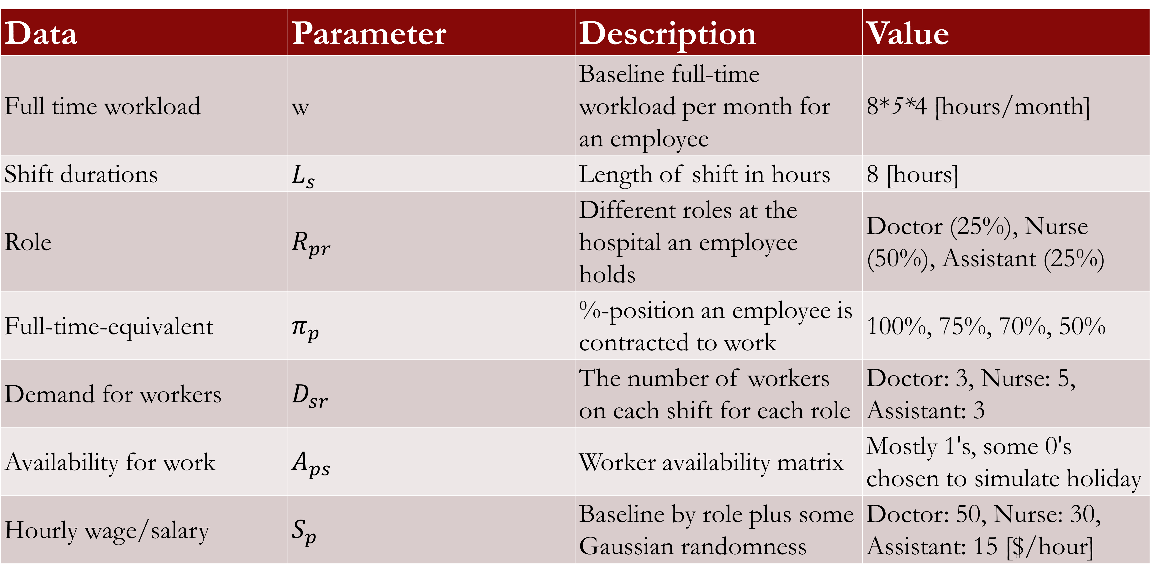
We generated data to accommodate for different scenarios
Data | Parameter | Description | Value
Full time workload | w | Baseline full-time workload per month for an employee | 8*5*4 [hours/month]
Shift durations | $$L_{s}$$ | Length of shift in hours | 8 [hours]
Role | $R_{pr}$​ | Different roles at the hospital an employee holds | Doctor (25%), Nurse (50%), Assistant (25%)
Full-time-equivalent | $π_{p}$​ | %-position an employee is contracted to work | 100%, 75%, 70%, 50%
Demand for workers | $$D_{sr}$$ | The number of workers on each shift for each role | Doctor: 3, Nurse: 5, Assistant: 3
Availability for work | $$A_{ps}$$ | Worker availability matrix | Mostly 1's, some 0's chosen to simulate holiday
Hourly wage/salary | $$S_{p}$$ | Baseline by role plus some Gaussian randomness | Doctor: 50, Nurse: 30, Assistant: 15 [$/hour]

Slide 3
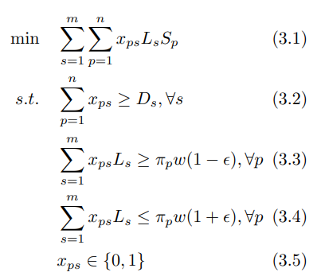
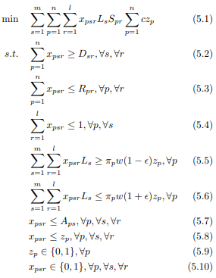
An iterative modelling approach capturing more and more complexities
Baseline Model
Full Model
Equation | Description
(5.1) | Minimize cost
(5.2) | All shifts must be covered
(5.3) | Role constraint
(5.4) | One role per shift
(5.5) | Max work constraint
(5.6) | Min work constraint
(5.7) | Availability constraint
(5.8) | Only work if hired
(5.9, 5.10) | Binary constraints

Slide 4
Key findings
Most employees are set up to work as much as possible
Doctors are set up to do both nursing shifts and assistant shifts
In scheduling, there is a fine line between feasibility and infeasibility
Flexibility should be modeled
Solution is an extreme point → “extreme solution”
Might not feel fair
Challenging to model tradeoffs
Scheduling is a very rich problem
Multi-objective approach might be more realistic

Slide 5
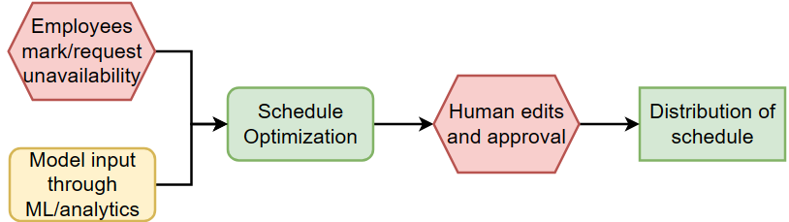
Impact of optimizing scheduling
Significantly reduce manual labor
Create better schedules faster
Useful analytics tool for uncovering problems
An important step in digitizing management
Figure: Schematic process diagram for future scheduling using Schedule Optimization.
Green: fully automized, red: human labor, yellow: requires some human labor.

